Slide 1
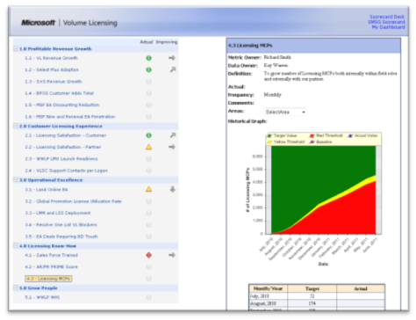
Sharepoint BI Scorecard
The Challenge
Microsoft’s Worldwide Licensing and Pricing needed a way to track the performance of their organization.
In addition, the project management office (PMO) was lacking a project lifecycle tool.
What We Did
Created business scorecard and business intelligence dashboard on top of SharePoint Server
Implemented project tracking solution so that project health could be monitored
Trained end users on both tools, allowing for easy updating
Results
This custom Business Intelligence dashboard is still being used 3 years after creation.
It has been praised for being flexible enough to meet the changing needs of the business.

